Slide 1
Lesson 1: Introduction to FTC Programming
Ben Schwarz

Slide 2
Firstly SETUP
YAY!
Firstly you need Java SE Development Kit (important it can't be any later): http://www.oracle.com/technetwork/java/javase/downloads/jdk8-downloads-2133151.html
Android Studio: https://developer.android.com/studio/
Get the Robot Project off of a USB

Slide 3
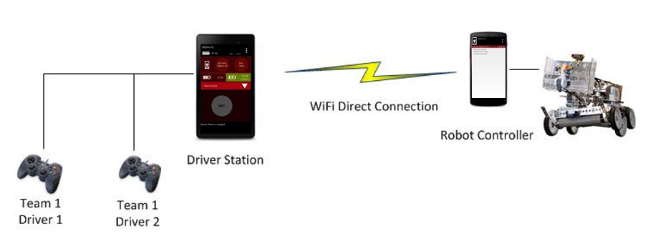
While that… Point-to-Point Control System
FTC uses Android devices to control its robot. During competition, each team has two Android devices.

Slide 4
To save time…
The ins and outs of the system are something best learnt in your own time. However a few things you should note:
One phone needs to be called TeamNumber-RC (Robot controller).
The other is called TeamNumber-DS (Driver Station).
https://github.com/ftctechnh/ftc_app/wiki/Managing-a-Smartphone-Robot-Controller

Slide 5
Now Time to start Coding…
Open the robot controller project in android studio.
This will take some time. It should take some time to Sync.
If it asks to download gradle stuff, click yes.
If Barker decides to block all of this SPEAK UP NOW

Slide 6
The Structure of FTC Coding
All your code is contained in Team Code.
There is sample code in RobotController

Slide 7
How does it work.
Two modes:
Driver Controlled (TeleOp)
Autonomous
All Hardware devices are created (should be created) in the Hardware Map. This keeps a consistent list of items throughout all of the code.
To explain the structure lets create a motor and write code to get it to move.

Slide 8
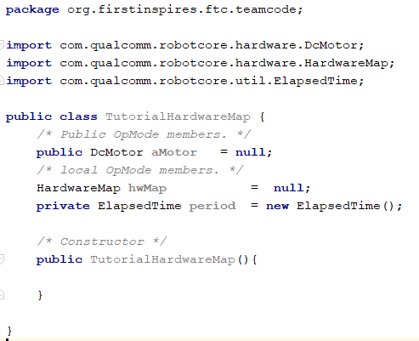
First we need a hardware map
Create a new class, name it HardwareMap
Add the following code:

Slide 9
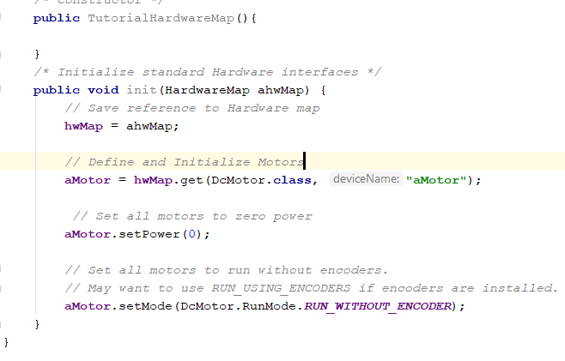
Now we need to initialise that motor
Code following on:

Slide 10
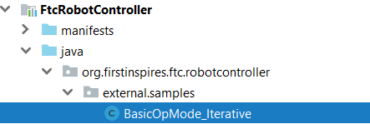
Creating an IterativeOpMode
We need to create a new class
However since this class requires a bunch of code, we will copy a template from external samples
Copy it over to your team code and give it a proper name.

Slide 11
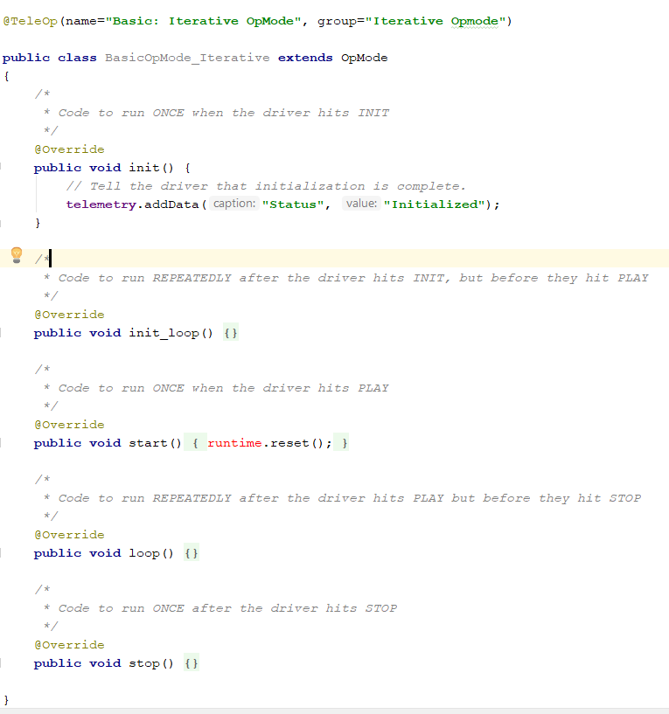
Deleting unnecessary code
Remove everything in between the first and last lines onscreen which you don’t see on the board
KEEP THE runtime part.

Slide 12
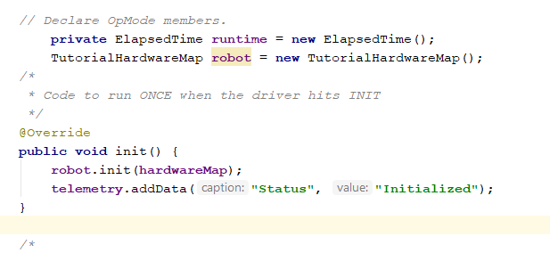
Initiating the robot
That is everything set up.
Now we can muck around with this motor

Slide 13

Example of mucking around

Slide 14
Activity
Delete that motor what is it for anyway?
Create 4 new motors. motorFrontLeft, motorFrontRight, motorBackLeft and motorBackRight.
Name them appropriately. (Remember they are objects so lowerCamelCase)

Slide 15
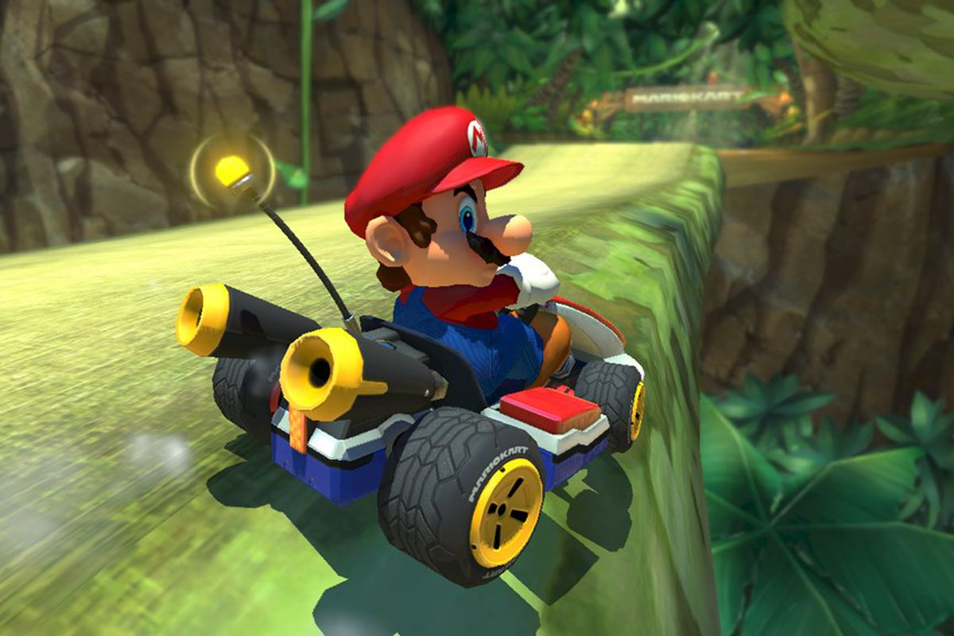
Time to drive the robot
Question: What is the best way to drive a robot.
Holding down the a button? Worked well enough in Mario Kart
Thoughts?

Slide 16
Well, if we are using analog joysticks
How do we turn? We are given an x and a y value, what do we do with them.

Slide 17
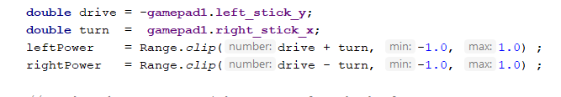
Solution
Left side: axis 1 – axis 2
Right side: axis 1 + axis 2:
Also remember, you need to clip speeds so that the motor values don’t go outside the range -1 to 1.’
New Task: Write code so you can control based off of the joysticks.
If you finish earlier, start setting up phones (I will help)

Slide 18
PROBLEM TIME:
What is the optimal way to convert joystick input into power?
Is it a straight linear system?
Given that due to friction the wheels won’t spin on a very low voltage.
Also generally the simpler the better as it means faster calculation time
To graph it I suggest using desmos or an alternative graphing website: https://www.desmos.com/calculator

Slide 19
Answer
There is no “right way.”
It changes depending on the system (e.g. a robot with high friction, compared to low friction wheels)
I like for our ftc robot a two speed system:
If fast speed: power = abs(0.7))
If slow speed: power = (abs(powpow(joystickvalue, (joystickvalue, 0.55))/(2)
If joystickvalue < 0: power*=-1
Shown on this link: https://www.desmos.com/calculator/duffrjux6n
On the frc robot this year we used a linear approach (unless the code lied to me)
When deciding your controls, experiment and use what feels best to control

Slide 20
Activity
1. Write code for the arm, intake and outtake. This should run off of a different controller. Decide what you think is the optimal method for controlling these. Consider if changing the speed is a priority for a motor and then map input controls accordingly. *I used the joystick to control the lift.
Try outputting to telemetry different values: a. motor power, b. values from controller.
Try manipulating the conversion from joystick values to motor power. Add some roots or powers. Try adding a half speed button. Whatever you see fit to make the robot easier to control
Track how long each iteration of the loop takes and output it to telemetry

